Slide 1
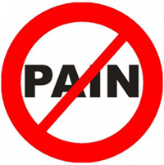
Specialty Devices for Pain Management

Slide 2
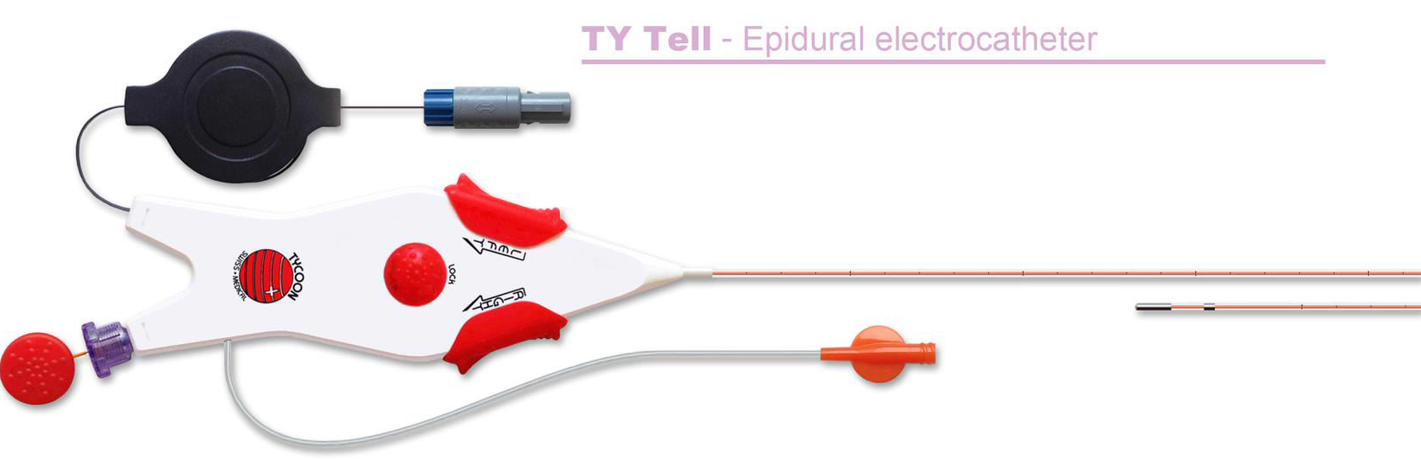
Pulsed RF Advanced Treatment :
Ty Tell

Slide 3
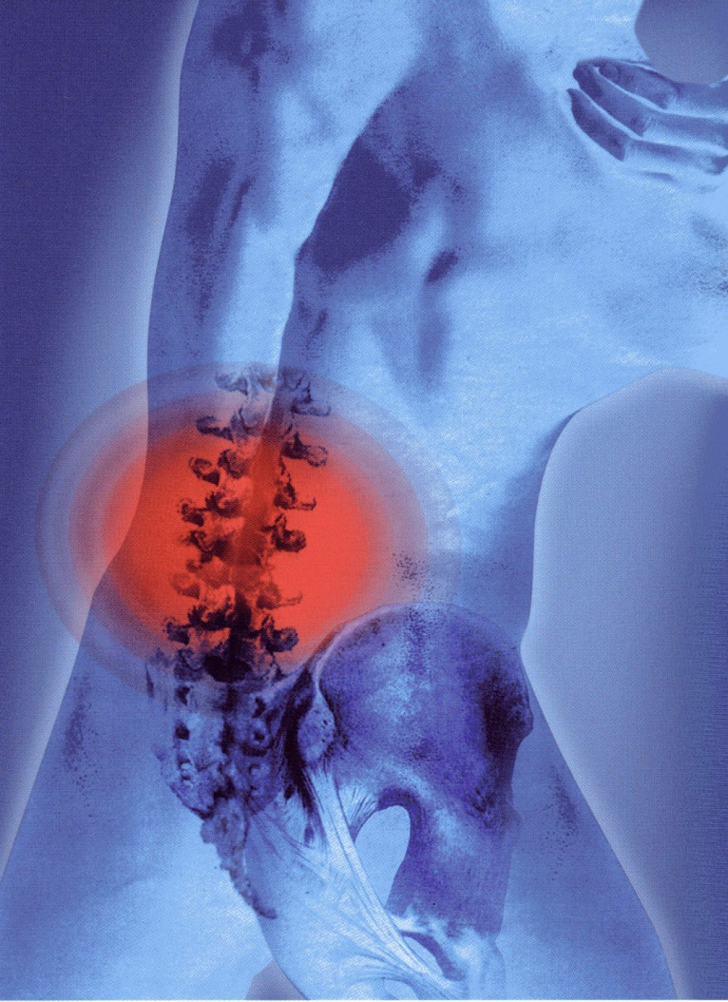
The Problem:
The Treatment of “neuropathic” chronic pain
Specifically
Multi-level spinal radiculopathies:
Cervical level
Thoracic level
Lumbar level

Slide 4
Some examples:
Lumbar sciatalgia;
Sciatica referable to L4-L5-S1 roots;
Cervical brachialgia
Postherpetic neuralgia;
Radicular lesions syndroms;
FBSS (Failed Back Surgery Syndrome)

Slide 5
The solution: Ty Tell
Epidural and trans- ganglion P.R.F. (Pulsed Radio-Frequency) steerable electrocatheter

Slide 6
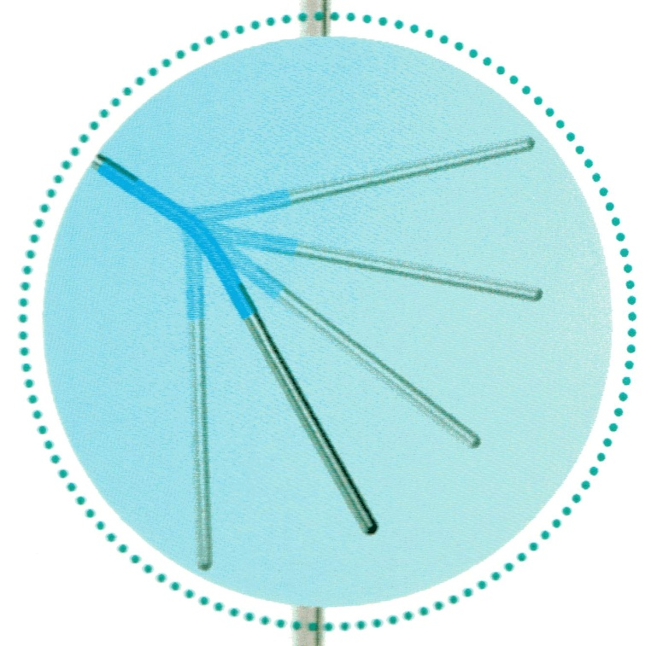
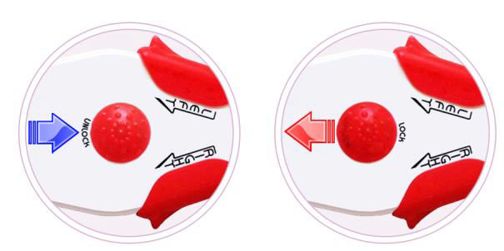
60 ° angle
Steerability: up to 60°
Distal active tip (electrode), 10 mm.
4F outer diameter, 300 mm length
Infusion from the very end tip of the catheter
Atraumatic
Locking system of the tip

Slide 7
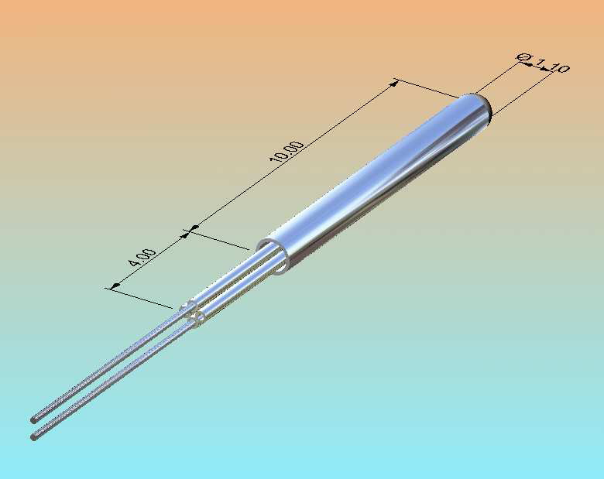
Micro- Technology

Slide 8
Key Features
Because of the steerable tip ( up to 60° angle) the target is easily reached when compared to non-steerable devices
No need to bend the tip by hand
Easier procedure in presence of acute angles (i.e. L5-S1)
Efficient and easy to use in case of multilevel / bilateral treatment
High efficiency of the current flow across the DRG or scar tissue due to the current flow optimization ( dedicated grounding cannula)
Quicker procedure, less Rx exposure
Less traumathic than adesiolysis

Slide 9

Patient positioning: prone
Surgical approach:
- Hiatus Sacralis
- Interspinosus
Procedure length: about 30 min.
Success rate measurable within
30 days after the treatment
The treatment can be repeated after
6-8 months in case of relapse

Slide 10
The catheter is inserted through:
- metallic introducer
- Seldinger introducer
The catheter is positioned under fluoroscopy
The correct positioning is evaluated by:
  Impedence measurement
  Sensorial Stimulation Test (50Hz)
  Motorial Stimulation Test (2Hz)

Slide 11
GOALS OF THE OPTIMIZATION CURRENT FLOW
(grounding cannula)
Increase the density of Electric Field on the DRG
To allow the current flow get across the scar tissue (anti-inflammatory effect without adesyolisis)
To reduce the voltage and the time of treatment in PRF, less risk of damages to the nervous tissue

Slide 12
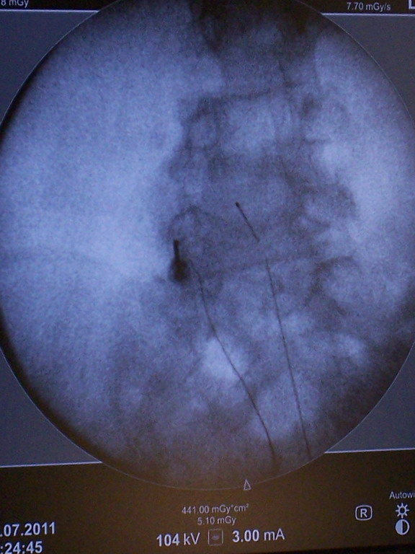
Catheter Positioning
X Ray Check

Slide 13
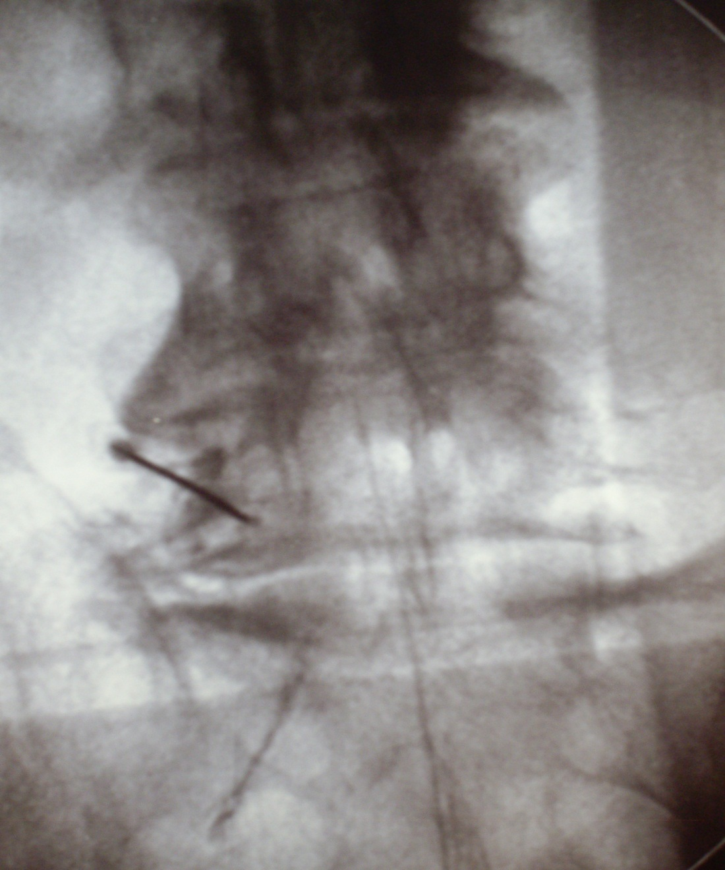
Optimization of current flow across the L4-L5 left DRG (a-p view)
Ty Tell electrode
Electric field
Ty Tell
Cannula with active tip

Slide 14
Treatment Parameters
Treatment Temp. : 42°C
Treatment Length: 240s (repeated when necessary)
Pulses Length: 20ms
Pulses: 2Hz

Slide 15
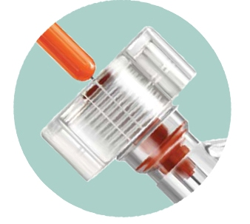
The device is provided with a stylet to allow, when necessary,
a higher level of rigidity

Slide 16
